Slide 1
Launcher

Slide 2
Introduction
Software as a Service (Saas)
Hosted on Cloud
Tiny application footprint
Your data stays within your organization
High availability and resilience built-in
Highly configurable
Built-in support for Microsoft Excel

Slide 3
Automation Challenges
Windows Task Scheduler
Has to be setup on each machine
Setting up same schedule on multiple machines is not easy due to resource contention
No ability to create job dependency to prevent a job from running if all of its dependencies have not run
Does not allow retries if one task fails
Does not have the concept of scheduling window to run tasks within it
Cannot detect if a task completed successfully

Slide 4
Launcher
Launcher can be hosted on multiple machines (pods) simultaneously
Guarantees synchronization of jobs among the pods
Detects job dependencies and runs jobs in the order defined by the scheduled time and dependency tree
Ability to launch Macros directly from Excel files

Slide 5
Launcher
Pods can be taken offline and brought online seamlessly
Tasks can be distributed among the pods depending on the pod workload and availability
In case of failure on one pod, another pod quickly picks up the job

Slide 6
Launcher – Front End
Provided as part of service
Hosted on Cloud
Shows the latest status of available pods
Shows real-time jobs status
Ability to launch on demand jobs

Slide 7
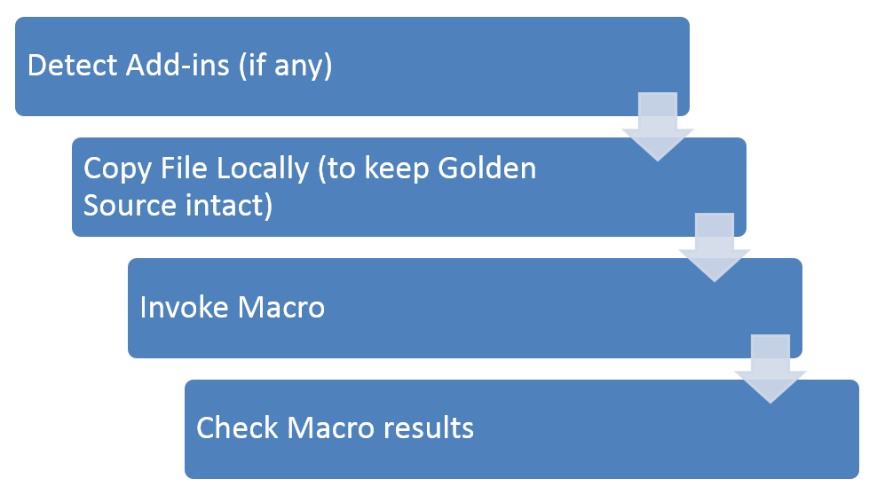
Excel Based Job

Slide 8
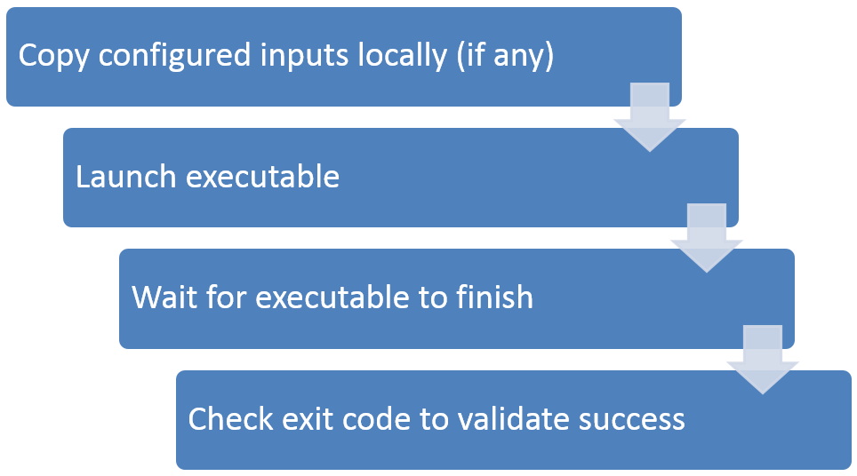
Executable Job

Slide 9
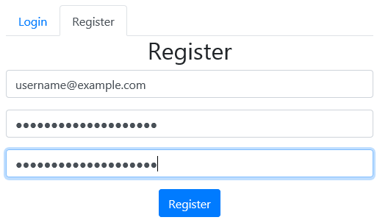
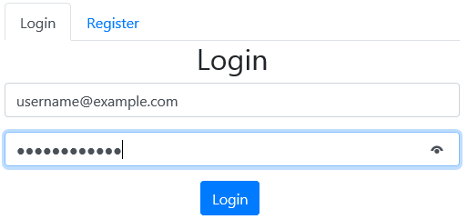
Registration

Slide 10
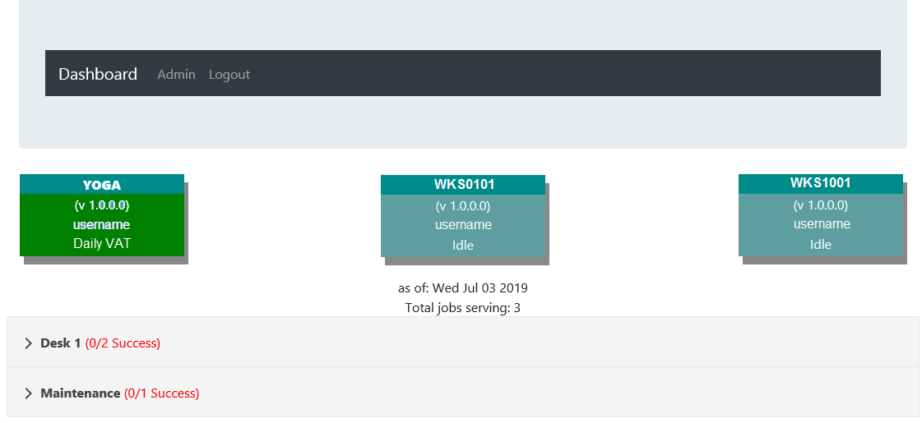
Pods Monitoring

Slide 11
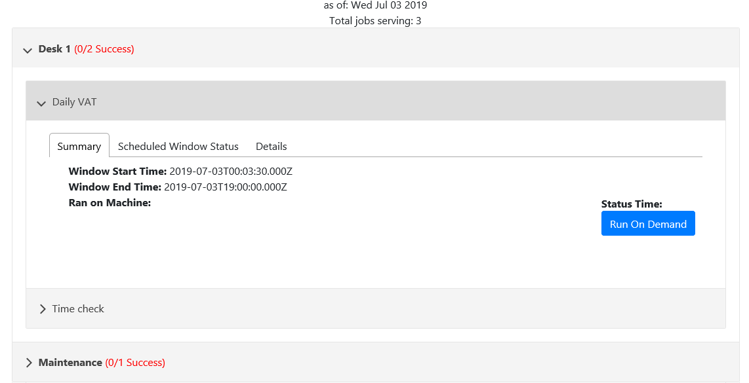
Job Status

Slide 12
Q&A
Contact:
EMEA
Mubashir Raja
+44 7805 638 879
mubashir.raja@logicloud.co.uk
AMERICAS
Saqib Umar
+52 331 723 6231
saqibumar@gmail.com

